Slide 1
Convolutional Neural Networks

Slide 2
Agenda
What are convolutional neural networks and how are they different from ANNs?
How do filters/kernels work for feature detection in CNNs?
How do pooling, padding and stride operations work in CNNs?
What is transfer learning and how can we use this in CNNs?

Slide 3
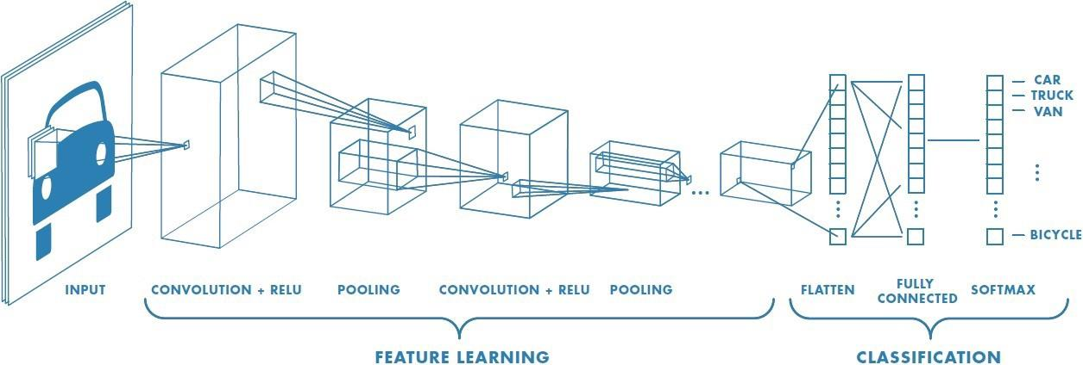
Convolutional Neural Networks
CNNs are a special type of neural network designed to work with image data. CNNs use convolutional layers - hidden layers which perform convolution operations. They have some different characteristics to ANNs:
Unlike ANNs, CNNs capture the spatial structure of the image
CNNs follow the concept of parameter sharing i.e. one filter is applied over the whole image, because of which they are much more computationally efficient.
The first part in this architecture is the convolutional layer followed by the pooling layer and the second part is the fully connected layer. This whole architecture is called a convolutional neural network.

Slide 4
The convolutional layer - Filter/Kernel
A convolution operation uses a small array of numbers called a filter/kernel on the input image.
Each filter is designed to identify a specific feature in the input space of the image, such as horizontal edges, vertical edges etc.
A CNN is able to successfully capture the spatial and temporal dependencies in an image through the application of relevant filters.
The role of the CNN is to reduce the images into a form which is easier to process, without losing features which are important for getting a good prediction.
This image shows how the convolution operation works in a CNN
It uses a 3x3 filter on a 5x5 image
The resulted feature is a 3x3 image which is the convolved feature

Slide 5
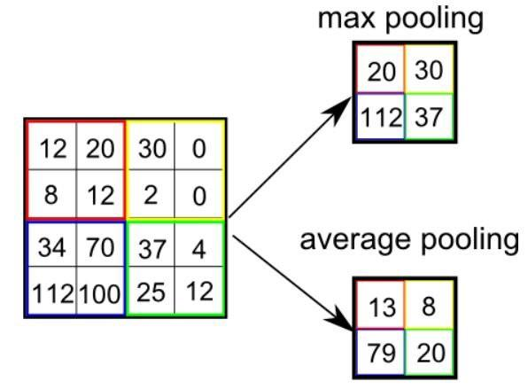
Pooling layer in CNNs
After a convolution operation, we usually perform pooling to reduce the dimensions of the feature map
It enables us to reduce the number of parameters, which both reduces the training time and the overfitting
Pooling layers downsample each feature map independently, reducing the height and width, but keeping the depth same.
There are two types of pooling - Max and Average
Max pooling just takes the maximum value whereas average pooling takes the average value in the pooling window
Contrary to the convolution operation, pooling has no parameters.
In these gifs, we can see how both max and average pooling work

Slide 6
Padding & Stride in CNNs
Stride specifies how much we move the filter at each step. By default the value of the stride is 1 and is represented by the first figure
We can also increase the value of stride if we want less overlap between the filters. It also makes the resulting feature map smaller since we are skipping over some locations.
The second figure demonstrates the stride 2
We see that after using stride, the size of the feature map is smaller than the input. If we want to maintain the same dimensions, we can use padding to surround the input with zeros.
The grey area around the input in the third figure is the padding.
We either pad with zeros or the values on the edge, to match the dimensions of the feature map with the input.
Padding is commonly used in CNNs to preserve the size of the feature maps, otherwise they would shrink at each layer, which is not desirable.

Slide 7
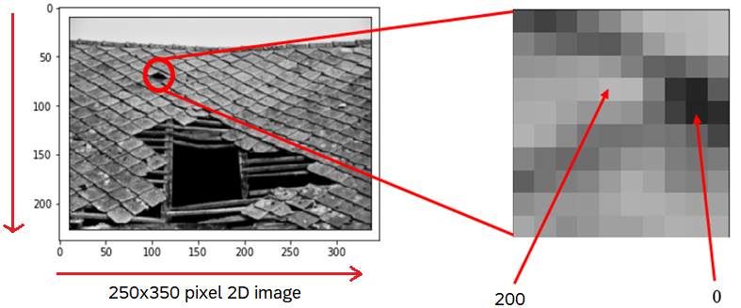
Convolutional Neural Networks
How computers interpret images?
Grayscale image
Notes:
Grayscale image has pixels that range from 0-255. O being the darkest and 255 being the brightest. After passing this image, the computers only see the numbers that are the numbers between 0-255 and are stored in a 2d numpy array. Gray scale has only one channel.

Slide 8
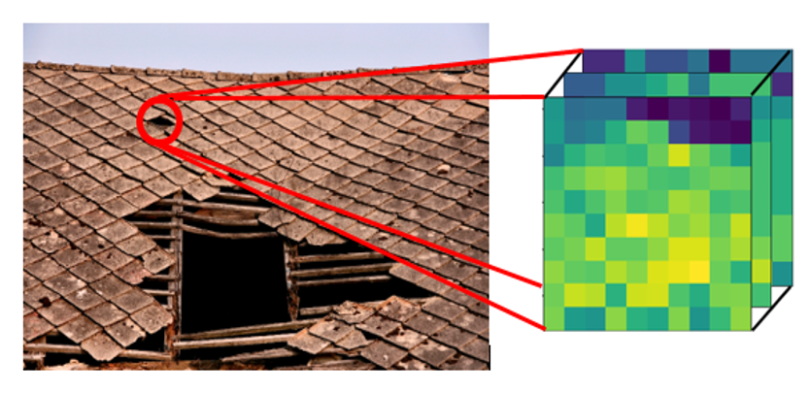
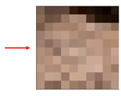
How computers interpret images?
When it comes to real-life applications, most images are in fact a 3D tensor with width, height, and 3 channels (R,G,B) as dimensions.
Blue channel
Green channel
Red channel
Colour image
Notes:
A color image has 3 channels. The numbers are stored in a 3d numpy array. The 3 channels when super imposed produce a colourful image.

Slide 9
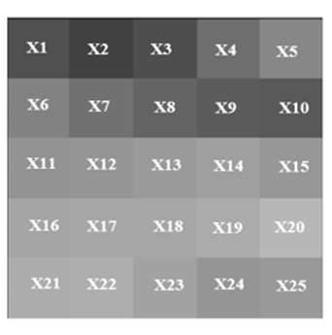
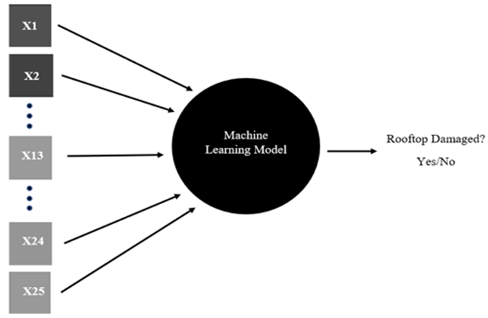
How computers interpret images?
This process of going from 2D to 1D vector is known as flattening. Because these networks cannot take 2D data as input.

Slide 10

Why CNN?
5 pixels
.
.
.
.
.
.
5 pixels
20 nodes
20 nodes
2 nodes
1st hidden layer
2nd hidden layer
output layer
25 nodes
No of Parameters = 25*20 + 20 = 570
No of Parameters = 20*2 + 2 = 42
No of Parameters = 20*20 + 20 = 420
Total number of trainable parameters = 570 + 420 + 42 = 1032 parameters only in 5x5 image with 2 hidden layers

Slide 11
Why CNN?
Large number of trainable parameters in ANN which increases computational complexity
ANN treats all image pixels as independent to each others
ANN does not take into account the spatial relationship between the pixels, so it fails to identify the patterns in the image pixels
Whereas, CNNs use sparsely connected layers which reduces total number of trainable parameters
CNNs accepts matrices as input, so we can explore spatial relationship between the pixels in the image

Slide 12
Why CNN?
The fully connected layer that we saw doesn’t respect the spatial structure of the input. If, for example, the input is an image, the NN will destruct the 2D structure into a 1-dimensional vector. To address the issue, we have designed Convolutional Neural Networks (CNNs). They work exceptionally well for computer vision applications.
1st row
spatial information between pixels is distorted
4 pixels
2nd row
4 pixels
Output
layer
3rd row
4th row
Fully connected
layer

Slide 13
Why CNN?
1st row
4 pixels
2nd row
4 pixels
Output
layer
Now, every hidden node is connected to a local
region of pixels and can find out the local patterns
in the image
Then output layers combines the findings of each
hidden nodes and predicts the final output
3rd row
4th row

Slide 14
Convolutional Neural Networks
Why CNN?
We can rearrange each of these vectors (input and hidden layers in previous layer) as matrices
4 pixels
Output layer
Convolutional layer
4 pixels
We can add more localized hidden nodes to find more patterns in the image
Convolutional layer

Slide 15
How Convolutional layers are generated?
We introduce kernels or filters with random weights which convolves over the whole image to create localized convolutional layer
0
1
1
1
0
0
0
1
-1
-1
4 pixels
-1
1
0
0
1
0
convolution operator
0
1
0
0
filter/kernel
4 pixels

Slide 16
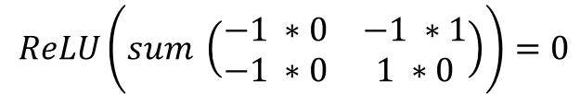
How Convolutional layers are generated?
We introduce kernels or filters with random weights which convolves over the whole image to create localized convolutional layer.
0
1
1
1
started learning
patterns of the
digit 7 (seven)
-1
-1
0
0
1
0
0
0
1
-1
1
0
1
0
0
0
1
0
filter/kernel
1
0
0
0
1
0
0
convolutional layer
input layer
$$ReLU\left(sum \left(\begin{matrix}−1 ∗0 & −1 ∗1 \\ −1 ∗0 & 1 ∗0\end{matrix}\right)\right)=0$$

Slide 17
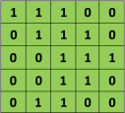


How Convolutional layers are generated?
Convolved feature or
feature map
$$=$$
filter
input layer
So what did we achieve here?
We transformed a 2D matrix from the input space to the feature space but without losing the 2D form of the input.

Slide 18
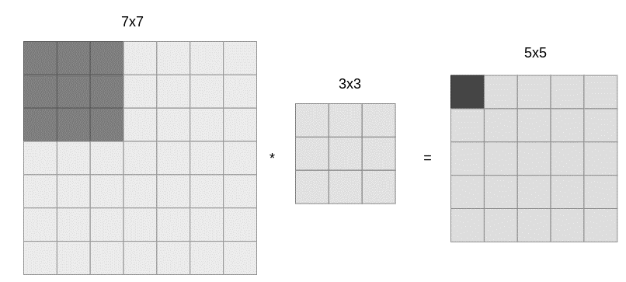
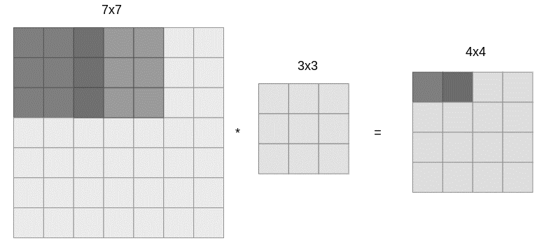
Spatial dimensions
Assume that we have a 7x7 image and a 3x3 filter. The feature map will be of size 5x5.
This is the most common approach but it is not the only one. Sometimes, we may want to slide/move every 2 pixels instead of every 1, thus introducing an extra hyperparameter called stride. If we introduce a stride of 2, we will receive an image of 4x4:

Slide 19
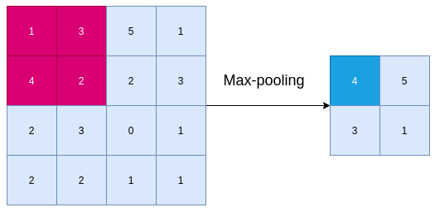
Pooling
Many popular CNN architectures utilize another type of layer besides the convolutional layer. Pooling layers do not contribute to the training of a neural network. These layers function in a similar form as convolutional layers in terms that we apply a function on a chunk of the input and produce a single scalar number. The most common way is known as max-pooling and works as shown below:
From each rectangular 2x2 chunk of our image, we keep only the bigger element in our feature map, resulting in a tensor with half the size of our initial input

Slide 20
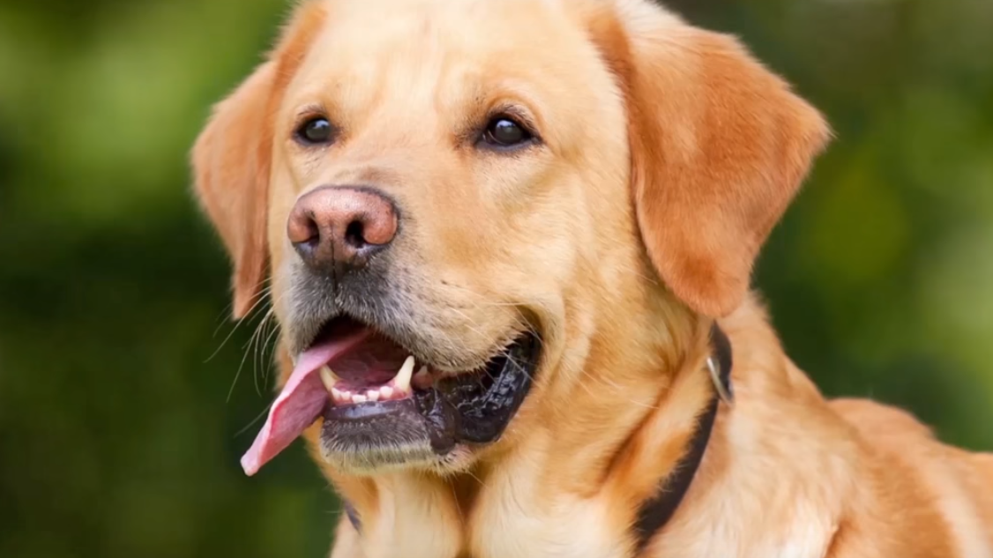
How many filters do we need?
We may like to detect:
Teeth
Tongue
Whiskers
So for every features in the image we will convolve different filters with respect to the image to detect
those features. For instance, one filter for teeth, one for tongue and another for whiskers and then we stack up those convolutional layers as one final layer.

Slide 21
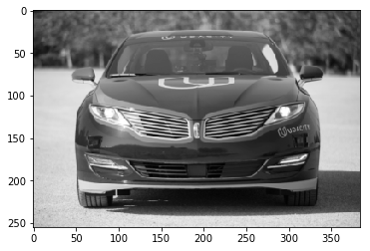
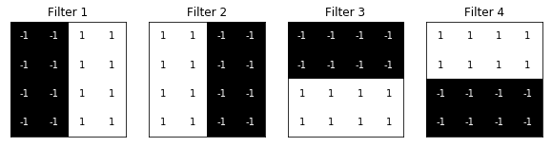
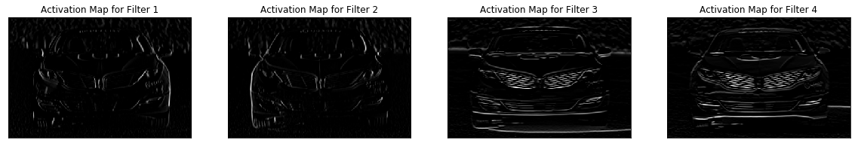
How many filters do we need?
input layer
four filters to detect four different
patterns in the image

Slide 22
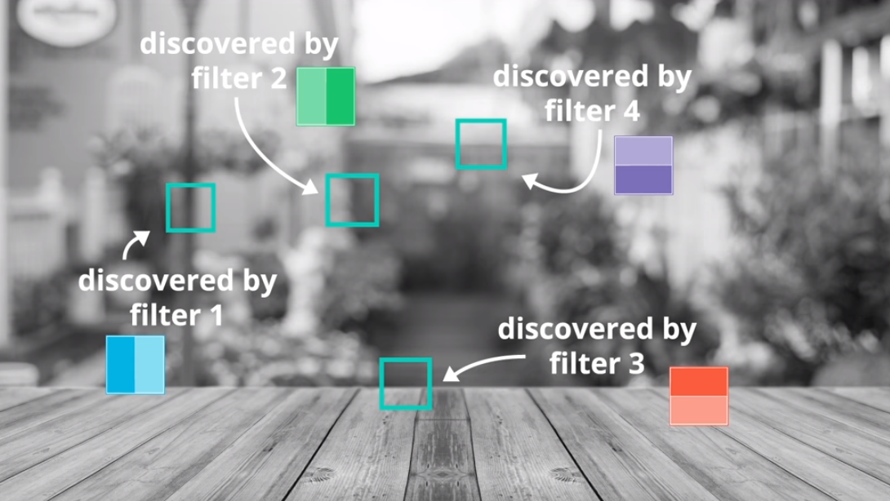
How many filters do we need?

Slide 23
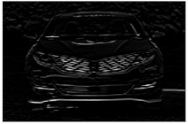
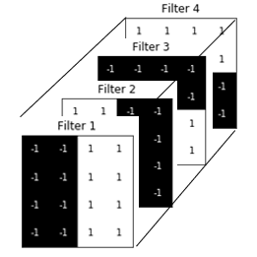
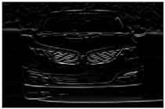
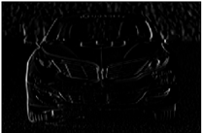
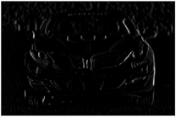
How many filters do we need?
input layer
filters
convolutional layer

Slide 24
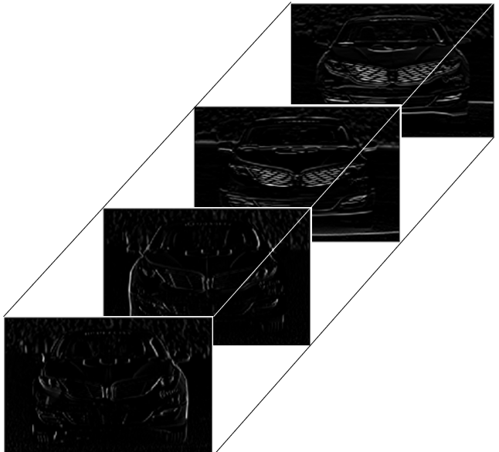


How many filters do we need?
$$\left[CONV LAYER\right]$$
$$\left[CONV LAYER\right]$$
Output
convolutional layer is passed through multiple
other convolutional layers to find out patterns
within the patterns (complex patterns)
convolutional layer

Slide 25
Tuning parameters in CNN
Number of filters
Size of filters
Stride of filters
Padding

Slide 26
Tuning parameters in CNN: Stride and Padding
0
1
1
1
1
0
1
?
1
-1
-1
0
0
0
1
0
1
0
?
-1
1
0
0
1
0
0
?
?
?
filter/kernel
0
1
0
0
0
1
0
0
0
0
1

Slide 27
Tuning parameters in CNN: Stride and Padding
0
1
1
1
1
0
0
1
?
0
1
0
1
-1
-1
0
0
0
1
0
0
1
0
?
1
0
0
-1
1
0
0
1
0
0
0
?
?
?
0
0
0
filter/kernel
0
1
0
0
0
0
1
0
0
0
0
0
1
Padding
0
0
0
0
0
0

